Slide 1


Faculty Profiles
Completing Your Faculty Profile
Click

Slide 2
Faculty Profiles
The electronic Faculty Profile system helps….
Faculty: All pertinent data is stored in one place and updates are required annually. Faculty members can and do update at any time. This represents an effective vitae or resume and faculty may draw on this information at any time.
Students: Faculty information management may be accessed by academic administrators. Utilizing this system increases the ability to place the best possible faculty member in the classroom.
University: Increases accuracy of information since faculty members input their own information. Also speeds up initial approval, and increases efficiency.
Click

Slide 3
Faculty Profiles
Faculty Profiles are accessible from the Faculty Web site and are made up of six specific classifications….
Personal Information
Demographics and contact information
Work History
Work title and responsibilities
Education History
Degrees, institutions, coursework
Click

Slide 4
Faculty Profiles
Faculty Profiles are accessible from the Faculty Web site and are made up of six specific classifications….
Instructional Experience
Teaching done in higher education
Scholarship
Listing of all scholarly activities over last ten years
Other Information
Legal questions, eligibility to work, etc.
Click

Slide 5
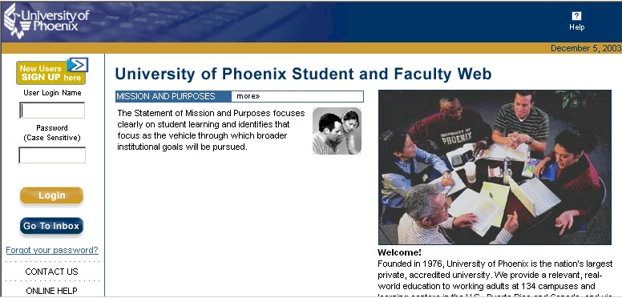
Faculty Profiles
Once faculty have completed their profile, they can access and edit their information at all times. The location for this is the eCampus Web site.
FacName
Password
Click

Slide 6
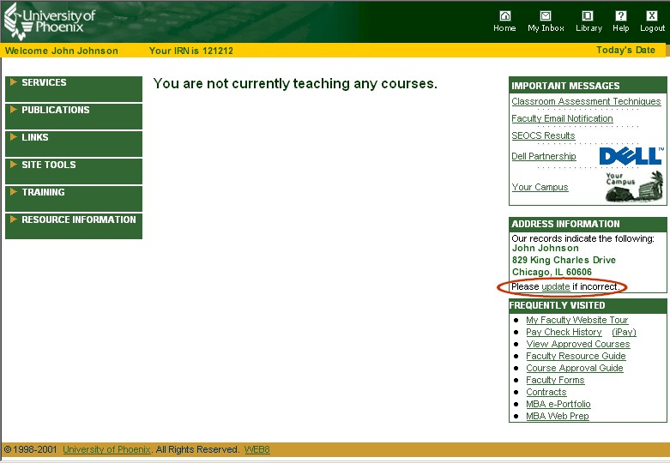
Faculty Profiles
The entry screen shows basic information currently stored in the data base.
Faculty are reminded to update information if it is not correct.
Faculty are also prompted to update the entire profile once a year.
Click

Slide 7
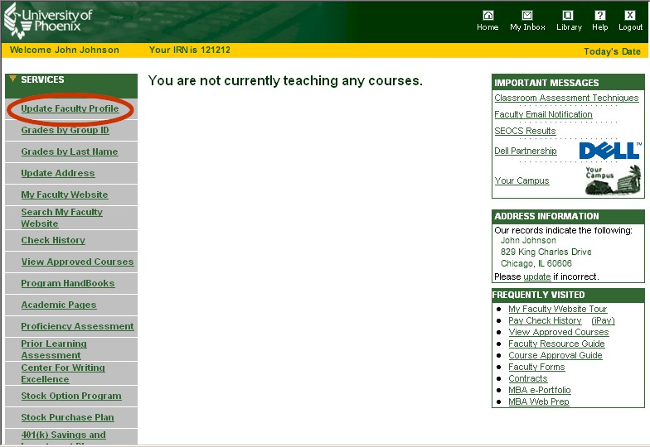
Faculty Profiles
Faculty may edit their entire profile at any time by clicking on the Services link.
Then click on
Update Faculty Profile
Click

Slide 8
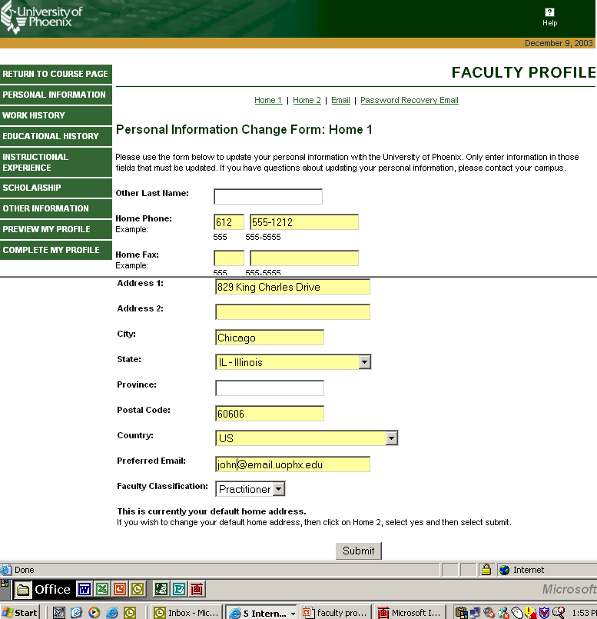
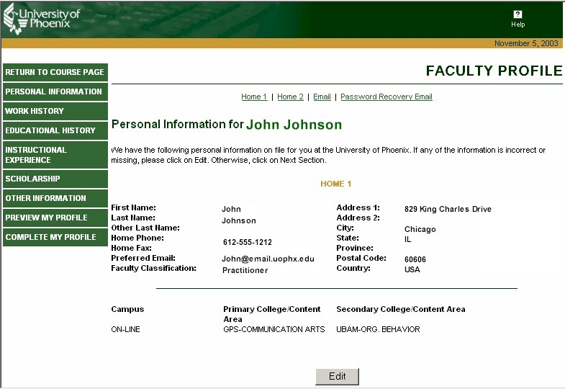
Editing information is very easy…
Faculty Profiles
Enter changes to profile
612
555-2323
Click on Edit
Click on Submit
Changes are made in real time
Click

Slide 9
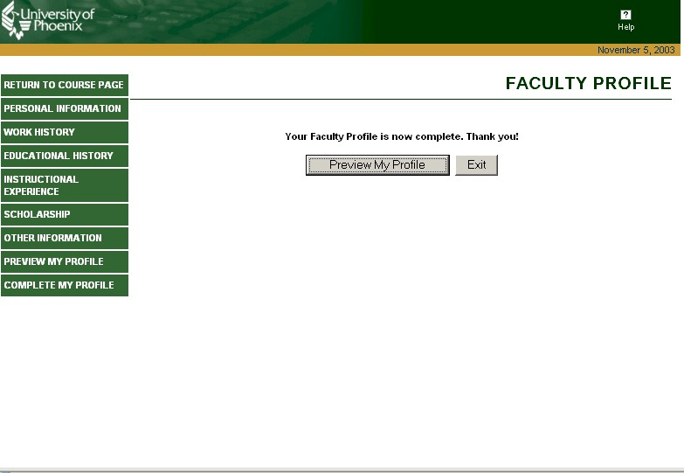

Faculty Profiles
Faculty can view updates immediately.
Click

Slide 10

Faculty Profiles
Faculty Scholarship:
The category that changes most often
Why:
The University fully supports, encourages, and recognizes the scholarship of a fully engaged faculty.
How:
The Scholarship model is based on the work of Ernest Boyer (1990)
Faculty are regularly engaged in scholarly activities.
Reporting these activities is facilitated on the Profile site.
Click

Slide 11
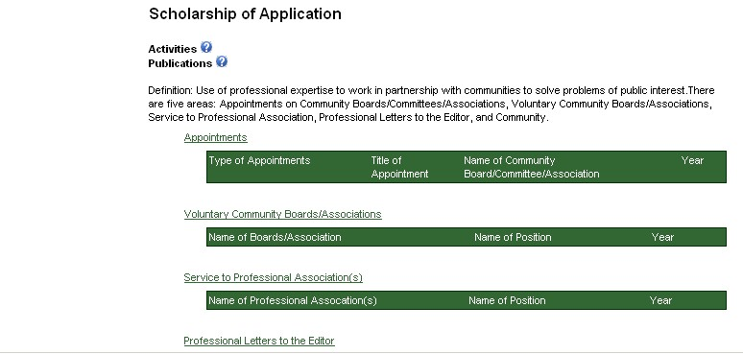
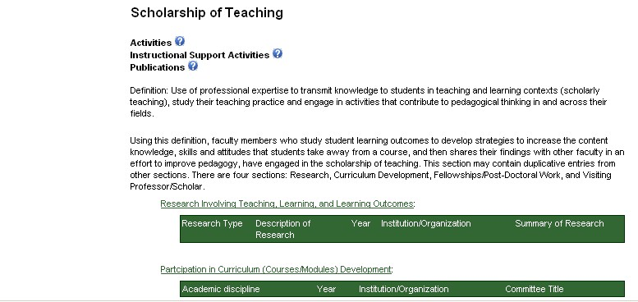
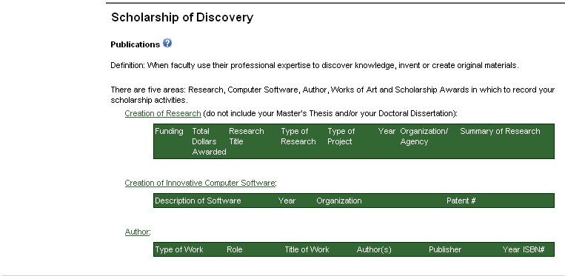
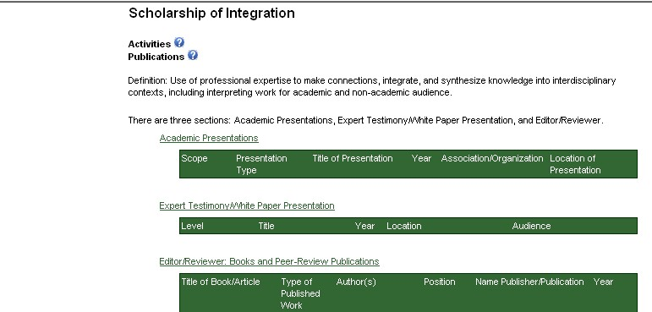
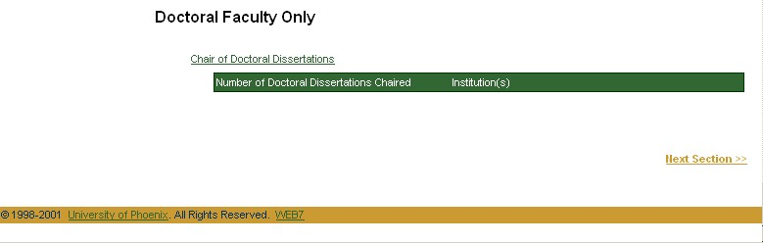
Faculty Profiles
Faculty Scholarship Categories*
Discovery
Teaching
Integration
Application
Chair of Doctoral Dissertations
(Doctoral faculty only)
*Based on the Boyer model (1990)
Click

Slide 12
Faculty Profiles
Thank You

